Slide 1
Final Project EMG 549
Trello
Liang Wei 94628
Huiyu Ma 94556
Xin Jin 93751

Slide 2
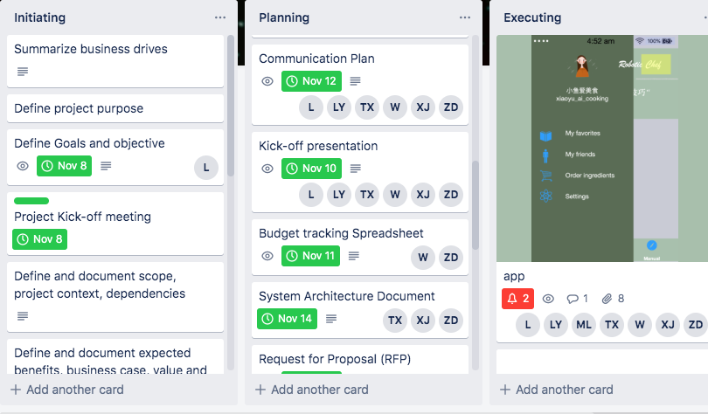
What is Trello - Liang
Cruz, M. (2017, March 16). Trello. Retrieved December 8, 2019, from https://www.slideshare.net/MichelleLynCruz/trello-73198801
Is a free online app for organizing ideas and processes
It can be used individually, or you can invite colleagues, families, and friends to work together
It's just like a pin board, you can create the checklist
Create a to do Board
add a list (lists of things)
add a cards in your lists, a list can have many cards
Don't forget to label it…

Slide 3
Advantages of Trello
Its visual, it used to manage a project, you can see how each step is done
Its versatile, it can be used in many ways like personal, team projects. It can be used for DIY Kanban, or collecting and organizing ideas.
Cruz, M. (2017, March 16). Trello. Retrieved December 8, 2019, from https://www.slideshare.net/MichelleLynCruz/trello-73198801

Slide 4
The Trello Tech Stack - CoffeeScript
Trello started out as a pure JavaScript project on both client and server
CoffeeScript is a language that compiles to readable JavaScript.
Well-written CoffeeScript smooths out and shortens JavaScript, while maintaining the same semantics, and does not introduce a substantial debugging indirection problem.
Brett. (n.d.). The Trello Tech Stack. Retrieved from https://blog.trello.com/the-trello-tech-stack.

Slide 5
The Client
BACKBONE.JS
When the data request returns, Backbone.js gets busy. We render each Model that comes down from the server with a View, and then Backbone provides an easy way to: Watch for DOM events within the HTML generated by the View and tie those to methods on the corresponding Model; as well as Watch the model for changes, and re-render the model’s HTML block to reflect them
PUSHSTATE
We use HTML5 pushState for moving between pages; that way we can give proper and consistent links in the location bar, and just load data and hand off to the appropriate Backbone-based controller on transition.
MUSTACHE
We use Mustache, a logic-less templating language, to represent our models as HTML.

Slide 6
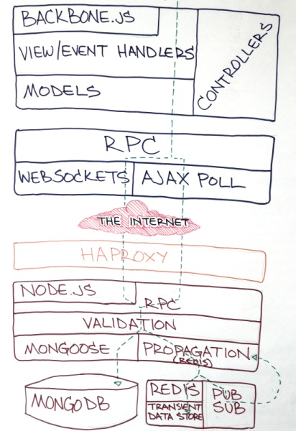
Pushing and Polling
SOCKET.IO AND WEBSOCKETS
Where we have browser support, we make a WebSocket connection so that the server can push changes made by other people down to browsers listening on the appropriate channels.
AJAX POLLING
When the client browser doesn’t support WebSockets, we just make tiny AJAX requests for updates every couple of seconds while a user is active, and back off to polling every ten seconds when the user goes idle.
Brett. (n.d.). The Trello Tech Stack. Retrieved from https://blog.trello.com/the-trello-tech-stack.

Slide 7
The Server
NODE.JS
The server side of Trello is built in Node.js. The prototype version of the Trello server was really just a library of functions that operated on arrays of Models in the memory of a single Node.js process, and the client simply invoked those functions through a very thin wrapper over a WebSocket. We used the prototype version to manage the development of Trello and other internal projects at Fog Creek.
HAPROXY
We use HAProxy to load balance between our web servers. It balances TCP between the machines round robin and leaves everything else to Node.js, leaving the connections open with a reasonably long time to live to support WebSockets and re-use of a TCP connection for AJAX polling.
rett. (n.d.). The Trello Tech Stack. Retrieved from https://blog.trello.com/the-trello-tech-stack.

Slide 8
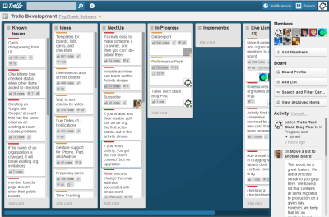
The Server
REDIS
Trello uses Redis for ephemeral data that needs to be shared between server processes but not persisted to disk. We run with allkeys-lru enabled and about five times as much space as its actual working set needs, so Redis automatically discards data that hasn’t been accessed lately, and reconstructs it when necessary.
Redis is also our pub/sub server, and we use it to propagate object change messages from the server process making the initiating request to all of the other server processes. Once you have a Redis server in place, you start using it for all sorts of things.
rett. (n.d.). The Trello Tech Stack. Retrieved from https://blog.trello.com/the-trello-tech-stack.

Slide 9
The Server
MongoDB
MongoDB fills more traditional database needs. In MongoDB, we give up relational DB features (e.g. arbitrary joins) for very fast writes, generally faster reads, and better denormalization support. Also, MongoDB is really easy to replicate, back up, and restore (the Foursquare debacle notwithstanding).
rett. (n.d.). The Trello Tech Stack. Retrieved from https://blog.trello.com/the-trello-tech-stack.

Slide 10
How to improve
However…
The Socket.io server currently has some problems with scaling up to more than 10K simultaneous client connections when using multiple processes and the Redis store, and the client has some issues that can cause it to open multiple connections to the same server, or not know that its connection has been severed.
There are some issues with submitting our fixes (hacks!) back to the project – in many cases they only work with WebSockets (the only Socket.io transport we use).
rett. (n.d.). The Trello Tech Stack. Retrieved from https://blog.trello.com/the-trello-tech-stack.

Slide 11
Trello API In Action
“What may be done at any time will be done at no time. ”

Slide 12
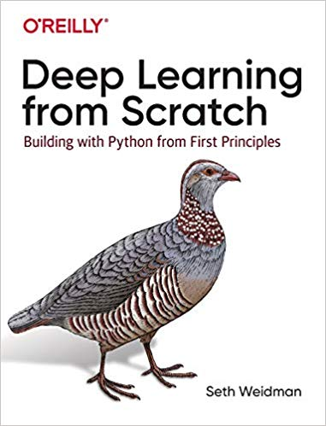


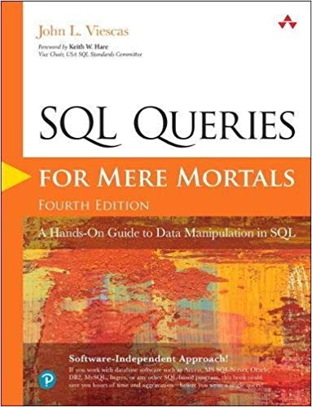


Slide 13



Slide 14
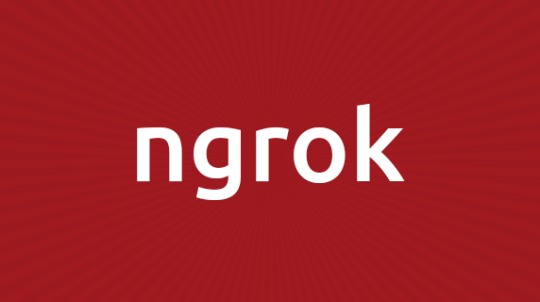


Slide 15
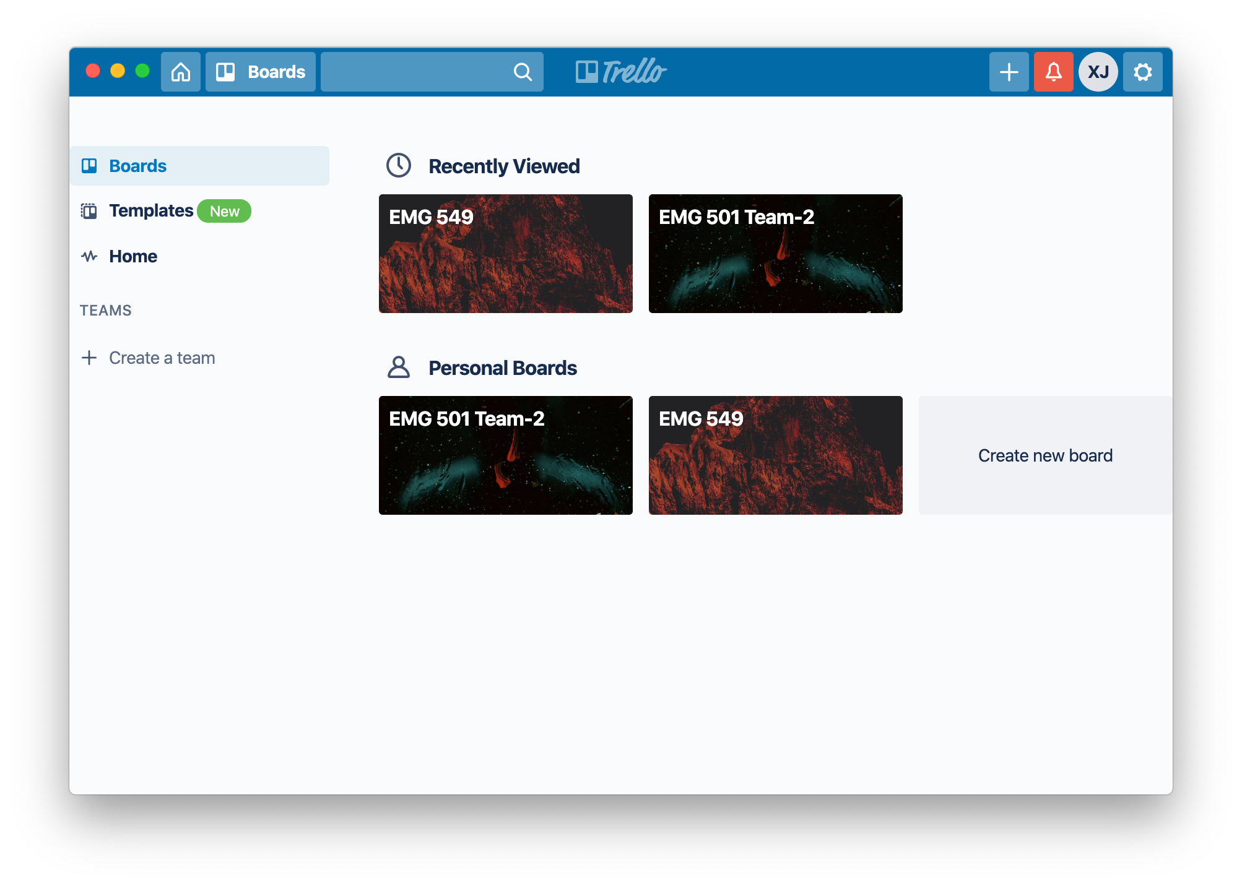
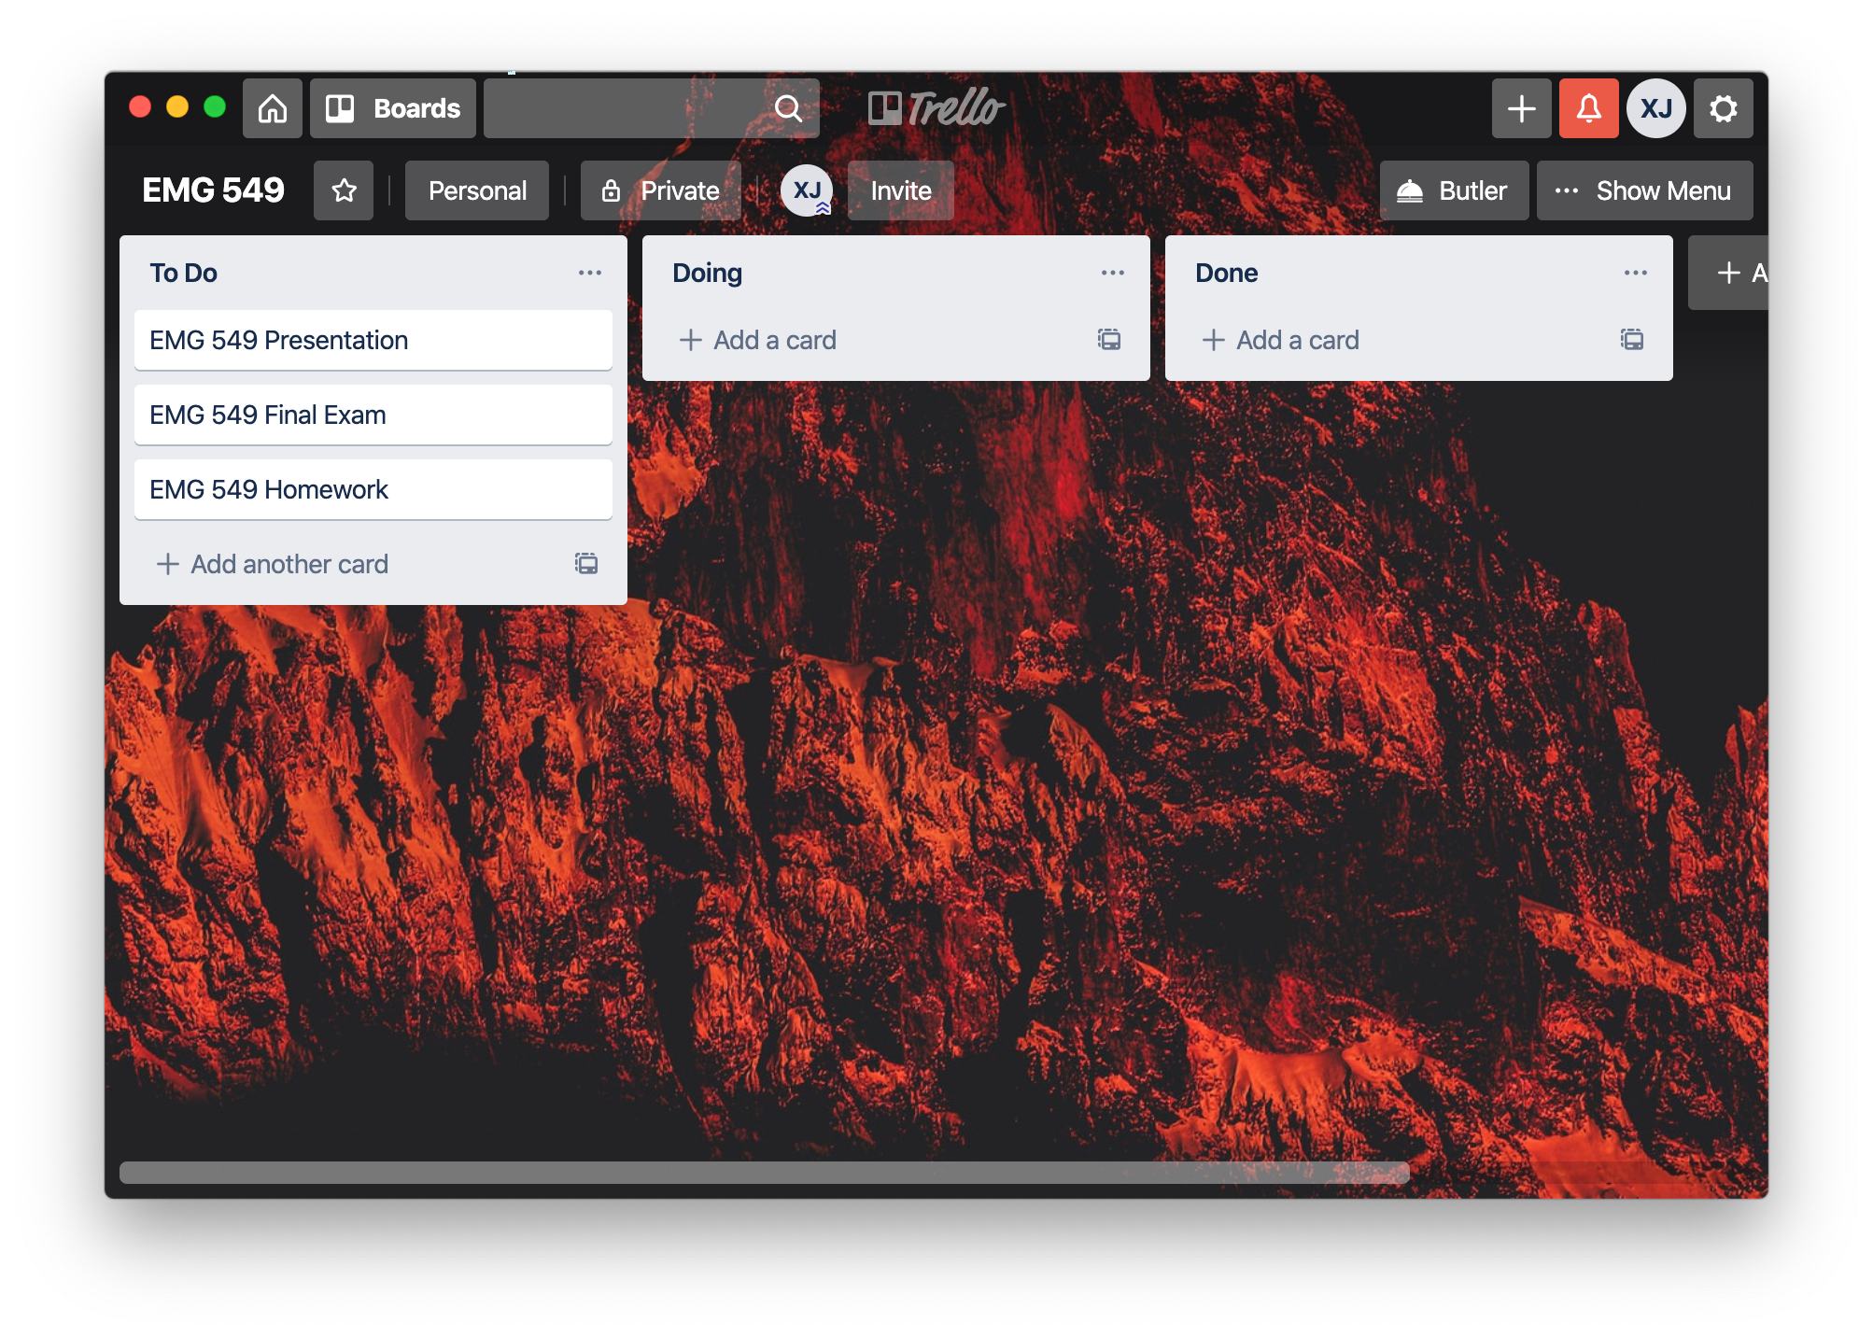

Slide 16
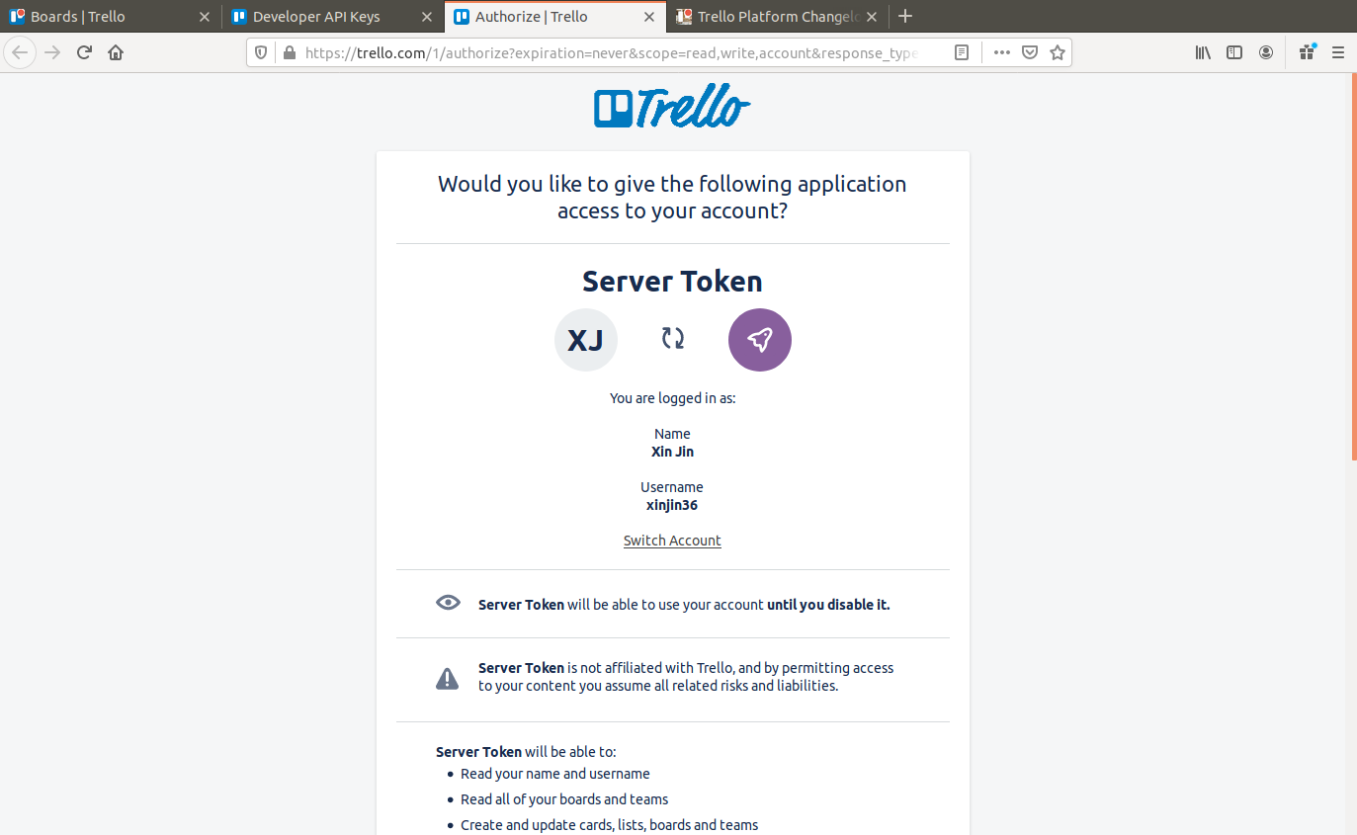
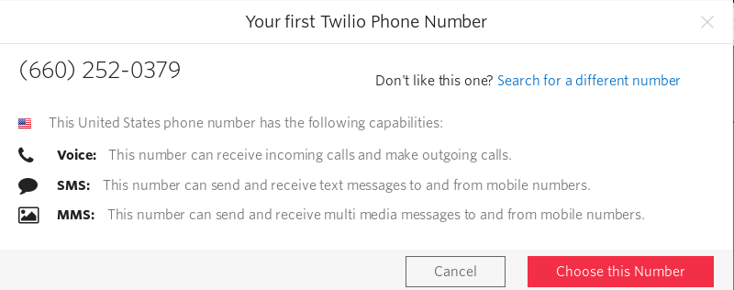
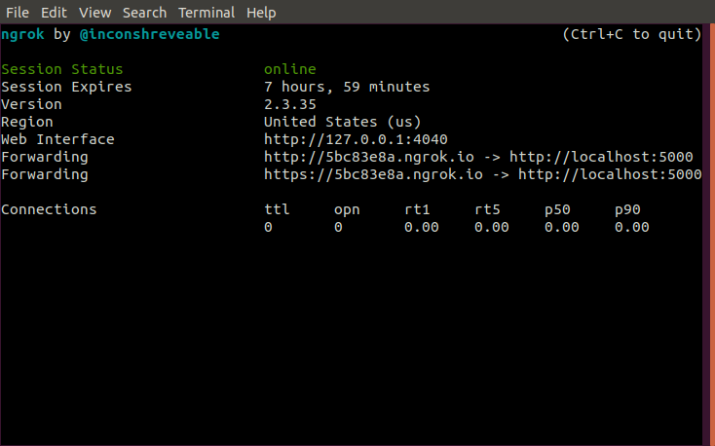
Trello API Key and Token
Phone number for SMS
Forwarding URL

Slide 17
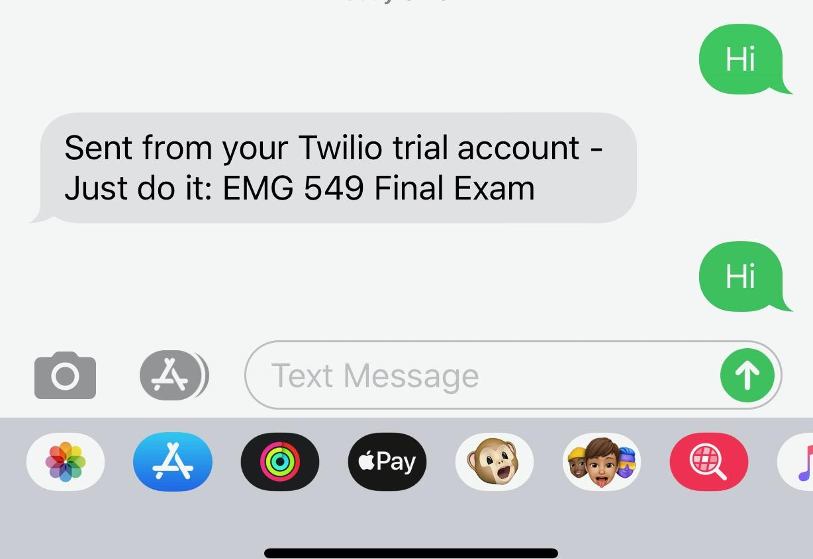

Slide 18
Please try it yourself
(660) 252 - 0379

Slide 19
Thank you
Any Questions?

